Slide 1
EYECARE.COM
-----Jason Lao

Slide 2
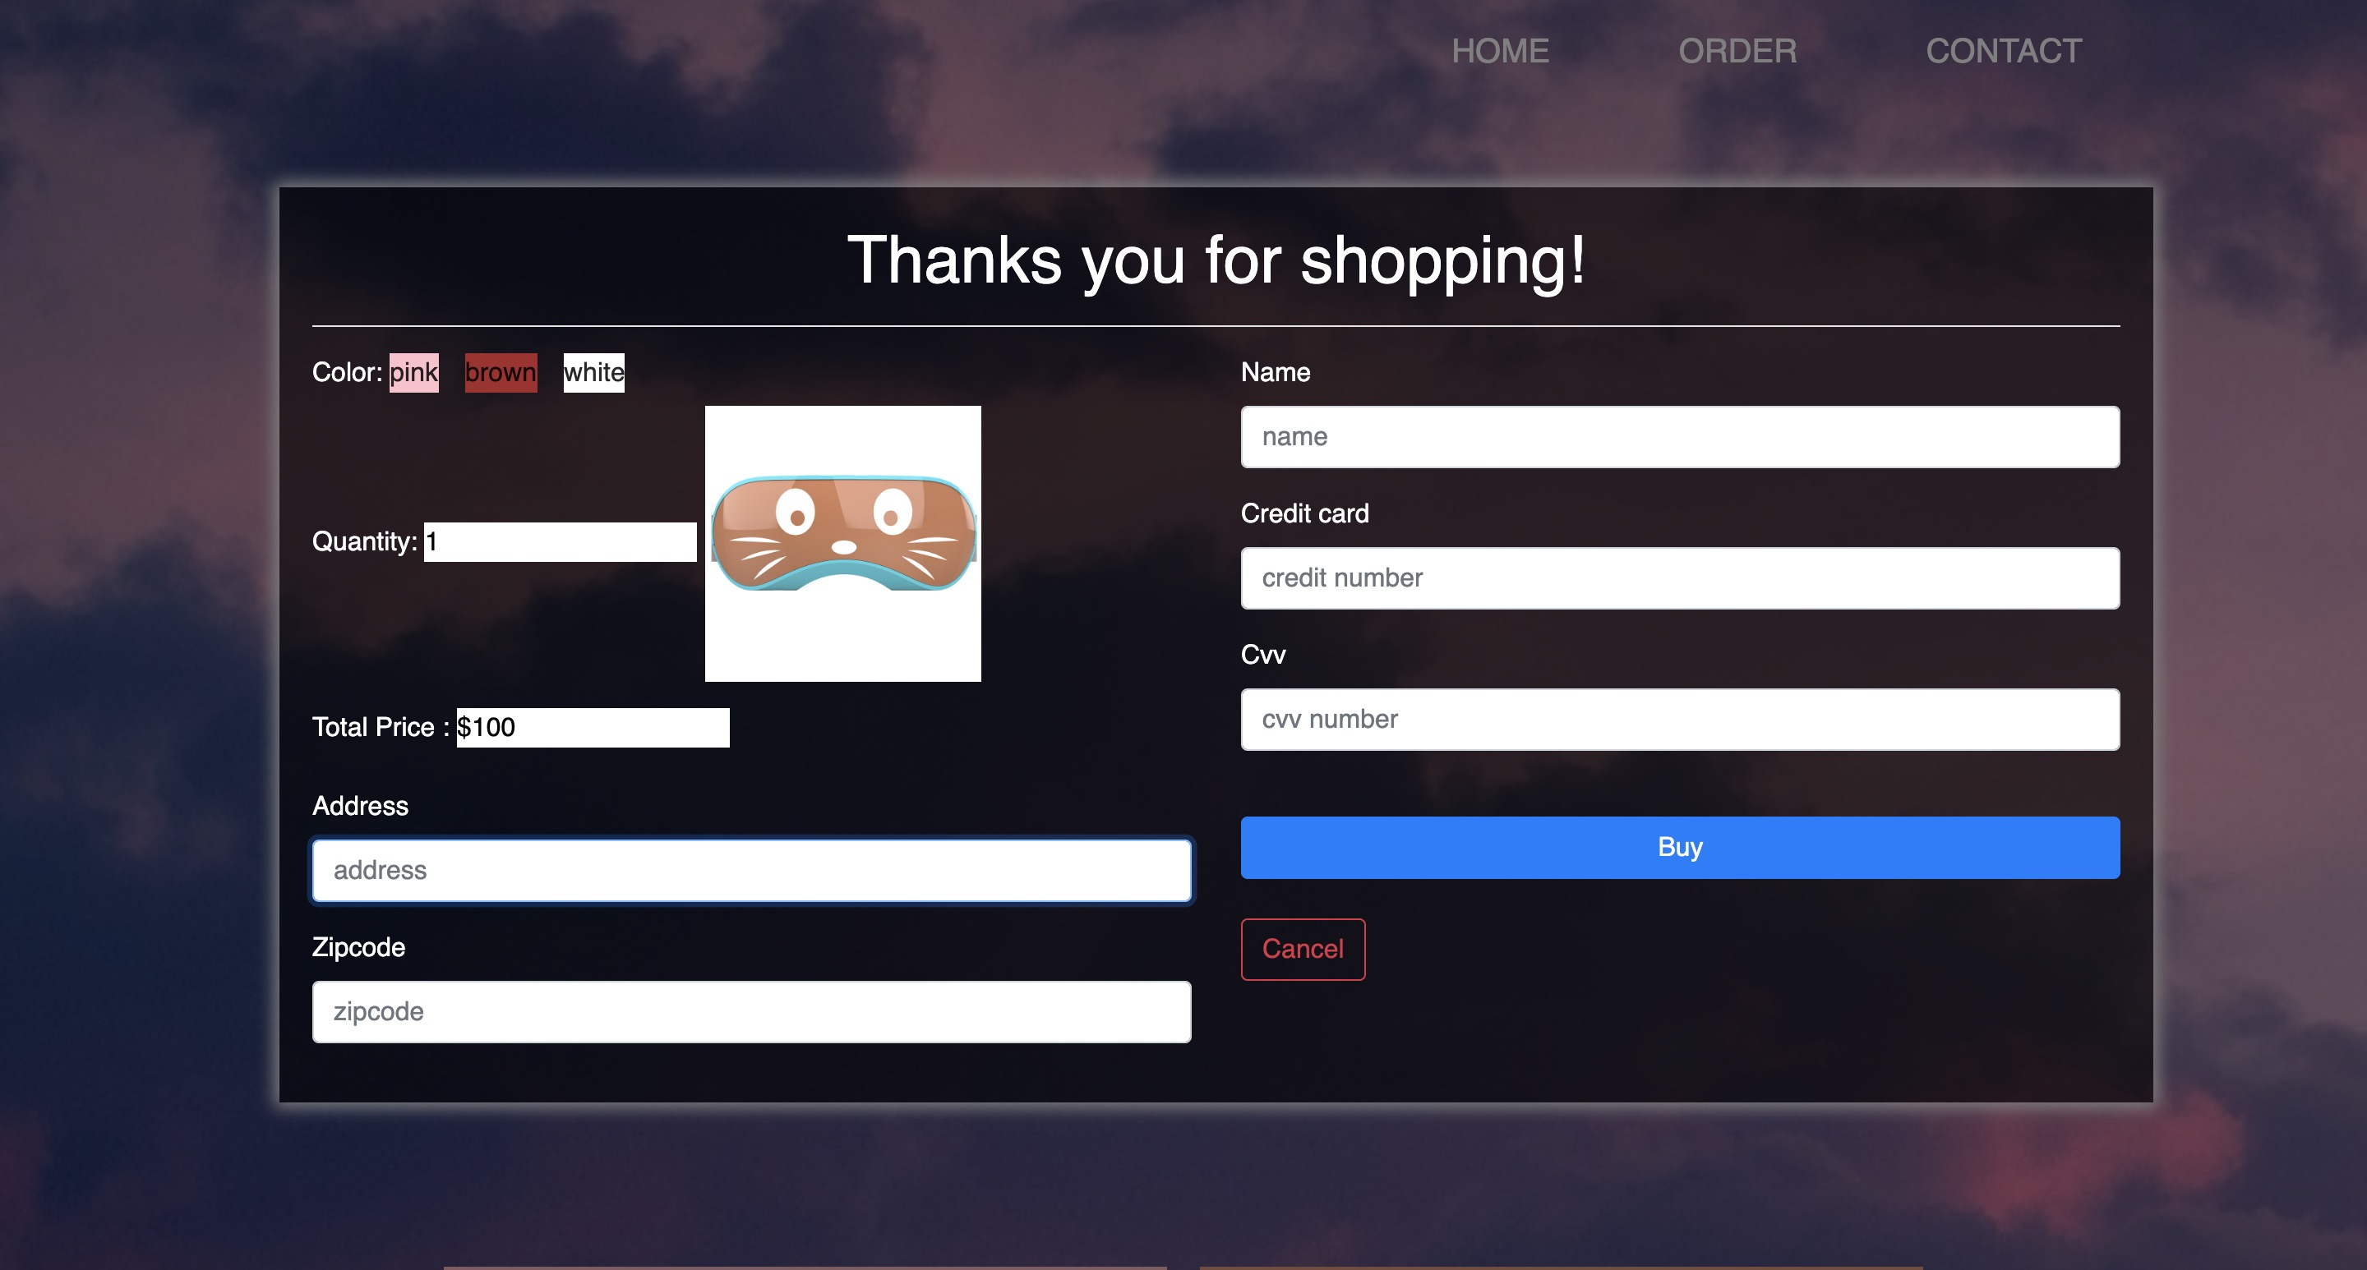
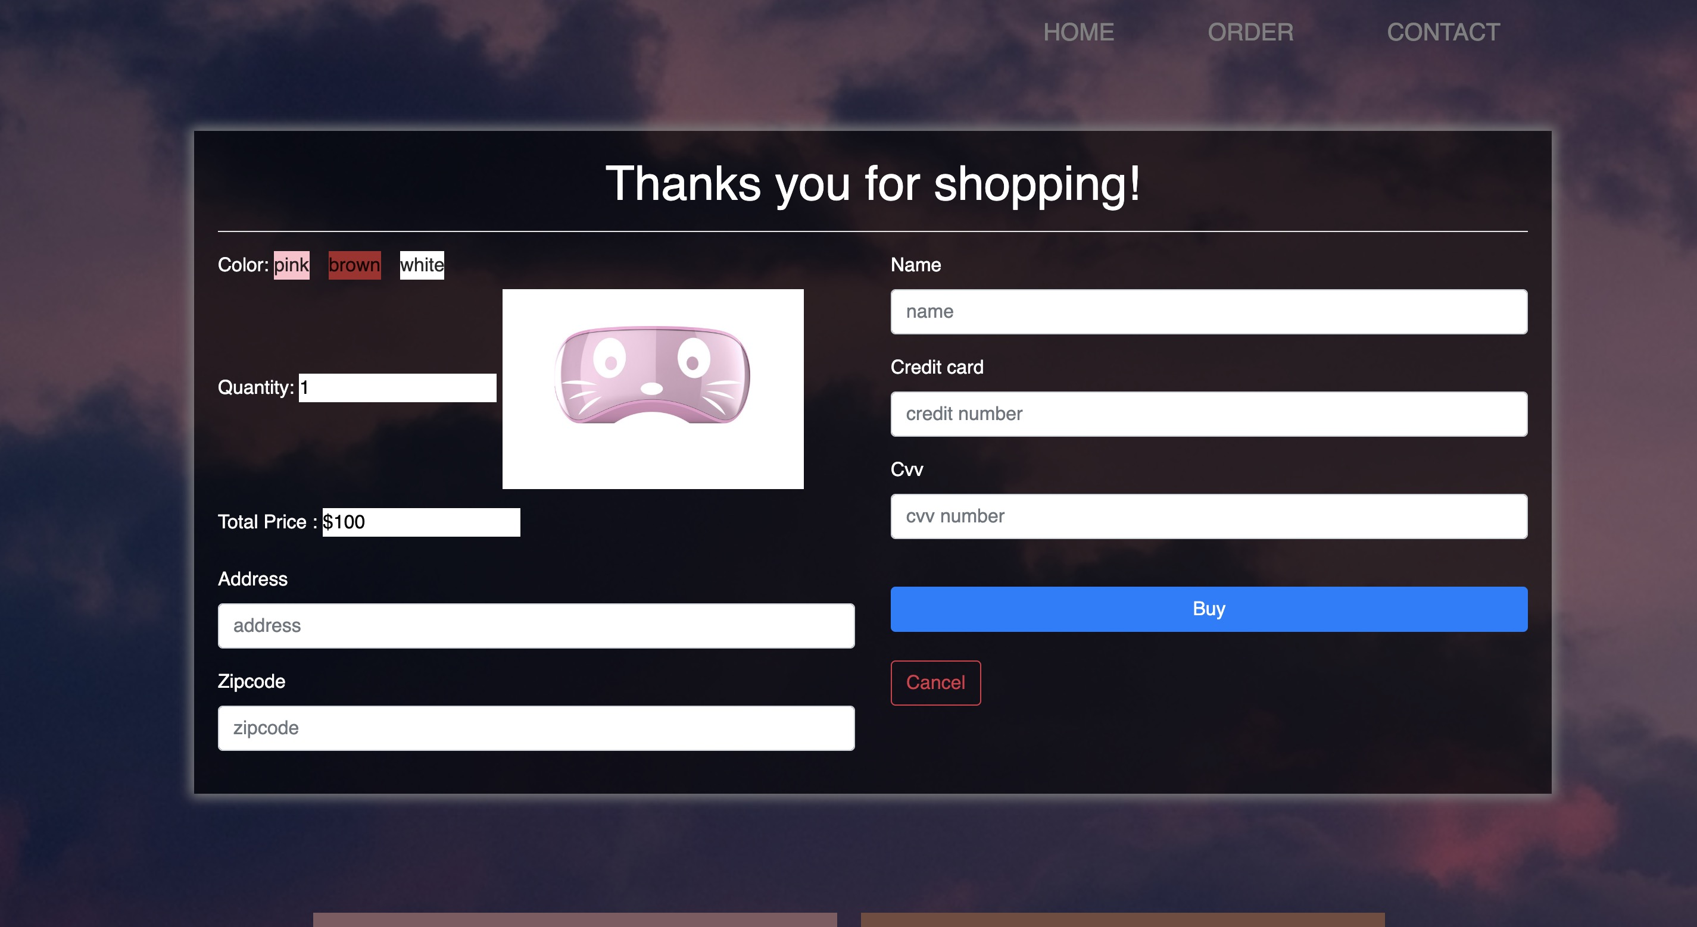
User story
As a user, I want to clik the“order now” button and give me the correct image of the item that i want to purchase.
As a user, I want to have a calculator to see how much i spend.

Slide 3
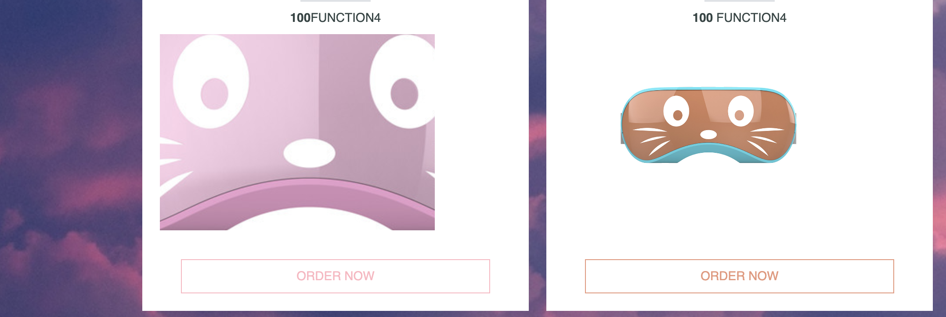
Story 2 ---- Magnifying glass
As a user , when i want to see the enlarged product details without opening a new page by swiping the image. So I made a magnifying glass.

Slide 4
Purpose: Sale products
Audience: People who are myopia and excessive use of the eyes
Staff: Jason finished the whole thing
Concerned about people's eye health

Slide 5
Major challenges
Hard to get the navigation bar to respond with animation .
Hard to make the price table and calculate how much the user spend.
Hard to make the magnifying glass in the right position.
Hard to use JavaScript hide the form
Hard to match the image in the order window to the one you clicked.
Other homework are also heavy, don’t have enough time to complete the quiz page.

Slide 6
If I have more time
Complete the quiz page which is let users answer the questions about eyes. For example, how to protect your eyes and how long do you use electronic products every day etc. And according to how many questions the users answer correctly set up different animations .
I will also make a separate page in order to upload some videoes about taking care eyes.

Slide 7
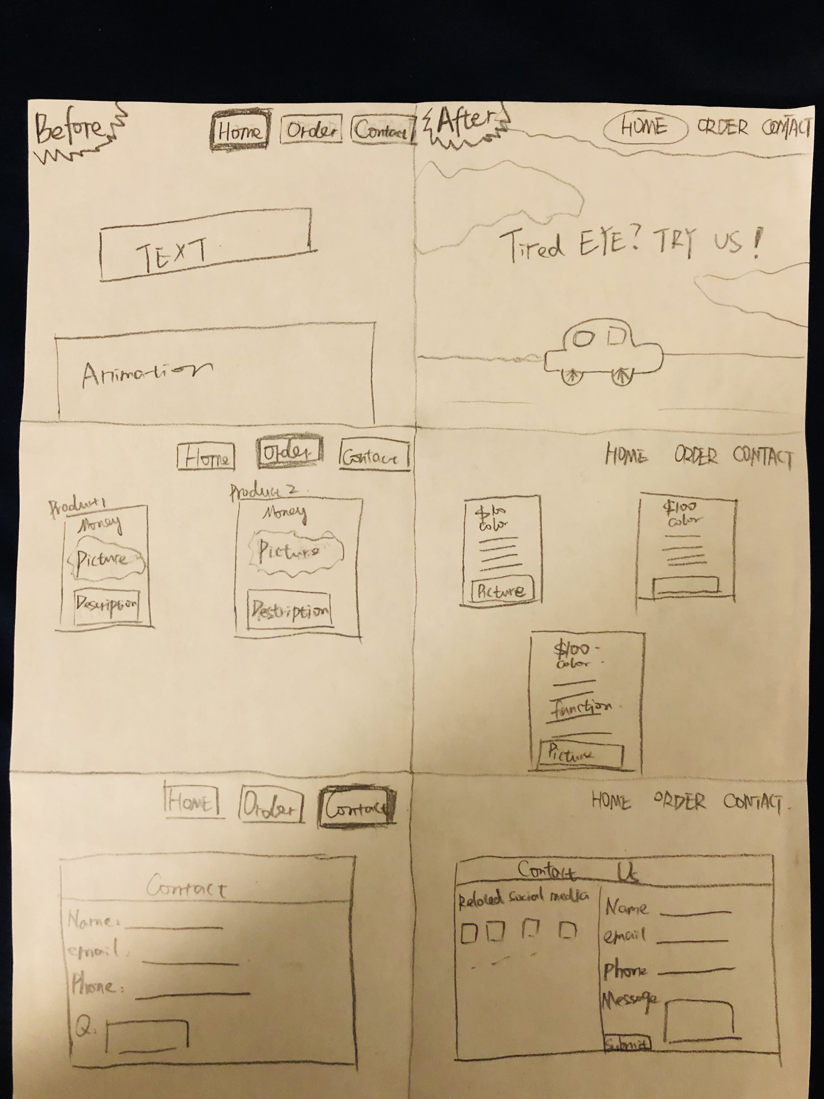

Slide 8
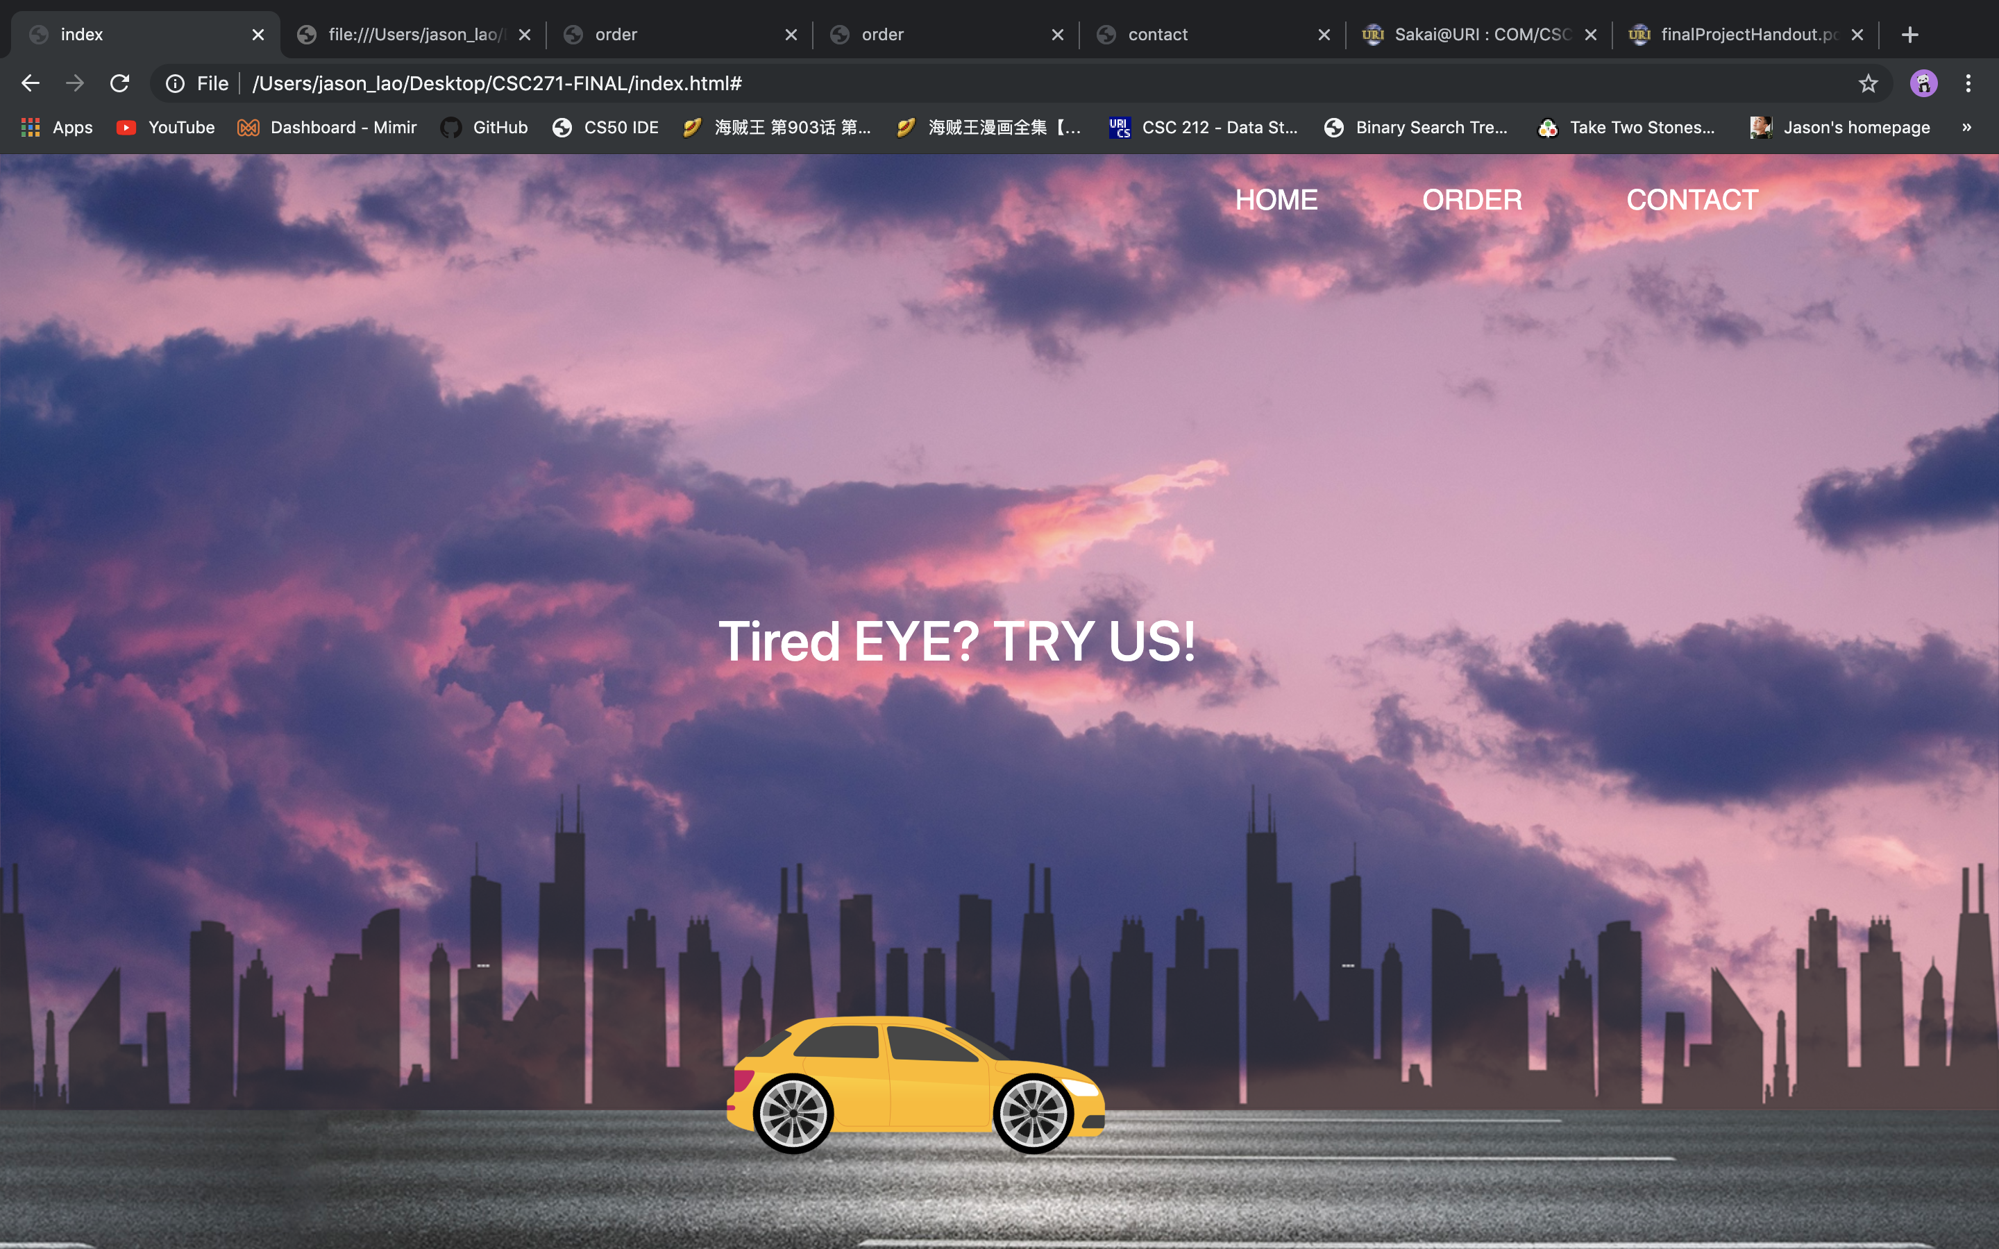

Slide 9
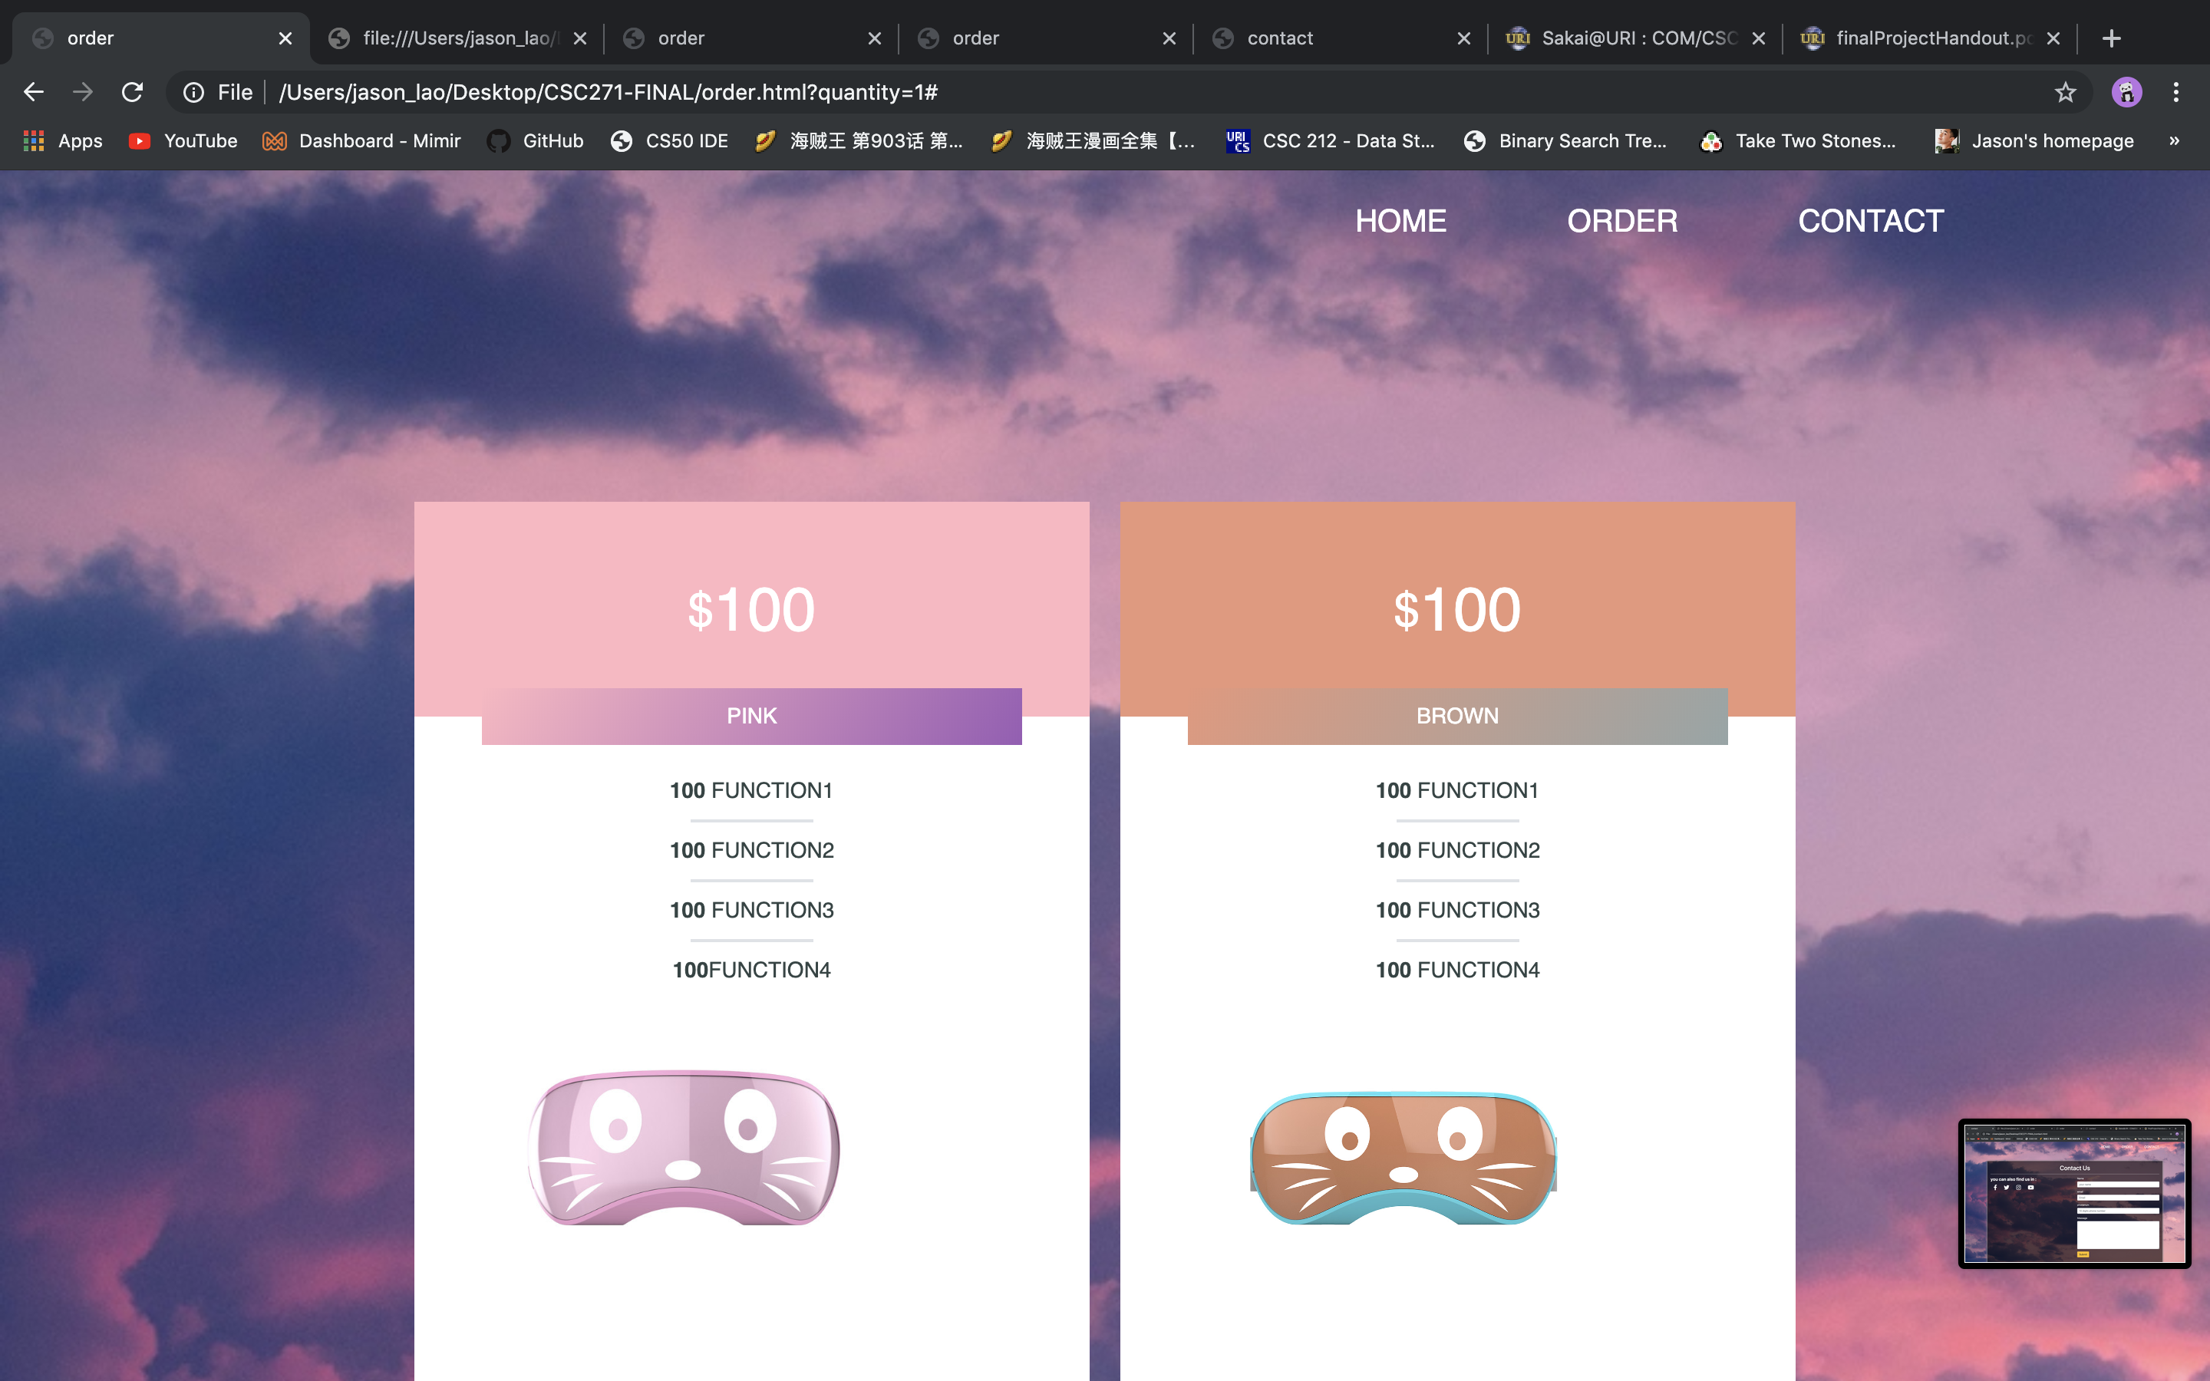

Slide 10
